Slide 1
Bengali Muslim Renaissance

Slide 2
By
Dr. Saleh Md. Shahriar Assistant Professor, DHP North South University Dhaka, Bangladesh
Initial: SaMS , Room# NAC 1031 Email: saleh.shahriar@northsouth.edu

Slide 3
The Bengal renaissance, the conviction of the triumph of ‘nava yuga’ (new age) and ideas of alternative modernity had contributed in defining the cultural process of 19th century Bengal (Anindita Ghoshal, “Introduction”, see her book titled, Refugees, Borders and Identities, 2021, Rutledge: London, page-11).
It is to be emphasized here that the “Introduction” ( pages 1-41) of the book, written by Dr. Anindita Ghosal, is a compulsory reading for all the students. The book has already been shared in the Canvas. PLEASE read the “Introduction” with great care and serious attention.

Slide 4
There were four aspects of the Renaissance movement, which the Bengali intelligentsia developed systematically throughout the nineteenth century.
First, there was the modernization of the Bengali language and the simultaneous birth of a new Bangali literature.
Secondly, there was the rediscovery of, and identification with an Indian classical era hailed as a golden age which placed South Asian civilization on a par with the grandeur of Greece and Rome.
Thirdly, there was the Sreerampore missionary interpretation of the Protestation Reformation, which Indians applied creatively to their own historic situation.
And finally, there was the secular view of universal progress on which India's hope lay not in resurrecting the past but in projecting the golden age into the future.

Slide 5
THE Bengal Muslim Renaissance refers to a socio-cultural, educational and religious reform movement during the nineteenth and early twentieth century in undivided India's Bengal province. It is said to have begun with Sir Sayed Ahmed (1817-1898).

Slide 6
SIR SYED AHMED KHAN

Slide 7
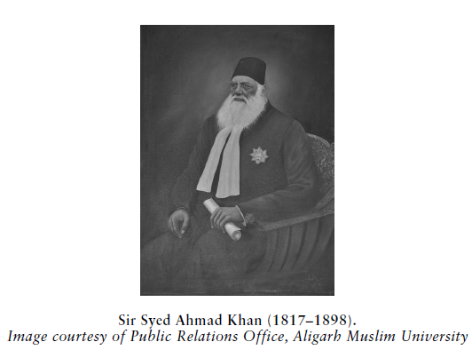

Slide 8
Muslim Renaissance in Bengal begins with Sir Syed Ahmad Khan .
He helped the Muslims to learn English to compete with the Hindus during the British period. They lagged behind the Hindus as they did not cooperate with the British when the British conquered India from the Mughals.
The Muslims believed that as long as the non-believers ruled India, the subcontinent was a 'Dar-ul-Harb' for Muslims and it was the duty of all to wage struggle against the British rule in order to regain the lost.

Slide 9
His writings, both academic and journalistic, initiate an informed debate on the social, cultural, religious, and political dynamics of the relationship between the Muslims, the Hindus, and the British (For details, please see, Shafey Kidwai’s book entitled, Sir Syed Ahmed Khan: Reason , Religion & Nation, London: Routledge, 2021).

Slide 10
Aligarh Movement of Sir Syed Ahmed Khan
To bring a change in the Muslim attitude , Sir Syed Ahmed Khan launched Islamic Renaissance through his Aligarh Movement. For him, Western science and technology strengthened Islamic convictions, since Islam was not dialectically opposed to reason. Our focus will be on the work and activity of Sir Syed Ahmed Khan.

Slide 11
Sir Syed Ahmed intends to achieve two goals:
Firstly, he wanted to minimize all grounds of animosity which the Muslims were likely to harbor against the British.
Secondly, he wanted to remove all doubts from the British mind that Muslims were not likely to be loyal to the British because their religion did not permit them to adopt such an attitude.

Slide 12
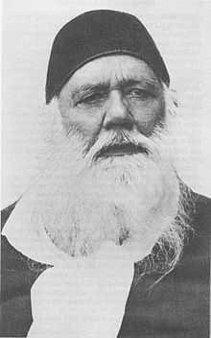
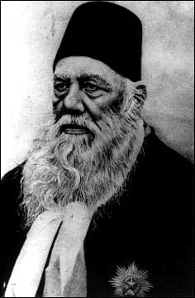
SIR SYED AHMED KHAN
SIR SYED AHMED KHAN SET UP A SCHOOL IN ALIGARH IN 1875
THIS THEN BECAME MOHAMMEDAN ANGLO ORIENTAL COLLEGE (MAO)
MOHAMMEDAN ANGLO ORIENTAL COLLEGE NOW IS KNOWN AS Aligarh Muslim University (AMU)
‘AMU’ STANDS FOR ALIGARH MUSLIM UNIVERSITY
HE WANTED THE MUSLIMS TO GET ENGLISH AND TECHNICAL EDUCATION
THIS WOULD HELP THEM IN PROGRESSING FORWARD EARN MONEY AND RESPECT
LIKE OTHER COMMUNITIES AND BECOME PROFESSIONALS
WHAT RAJA RAM MOHAN ROY DID FOR THE HINDUS, SIR SYED AHMED KHAN DID FOR THE MUSLIMS

Slide 13
Causes of the Indian Revolt of 1857:
Sir Syed Ahmed Khan wrote a monograph, titled, Causes of the Indian Revolt and he tried to find out the following root causes of the first war of Independence:
I. Non-representation of the Indians in the legislative councils
Forcible conversion of Indians to Christianity
Mismanagement of the Indian Army
British negligence to the Muslims community interests
V. And many other ill-advised measures of the Government which created large scale dissatisfaction among the various sections of society.

Slide 14
In his book The Causes of the Indian Revolt (1858), Sir Syed demands Indian representation on the Viceroy’s Legislative Council, and a few years later he joined the British Indian Association for the safeguarding of the interests of Indians (Shafey Kidwai’s book entitled, Sir Syed Ahmed Khan: Reason , Religion & Nation, London: Routledge, 2021, page-118)

Slide 15
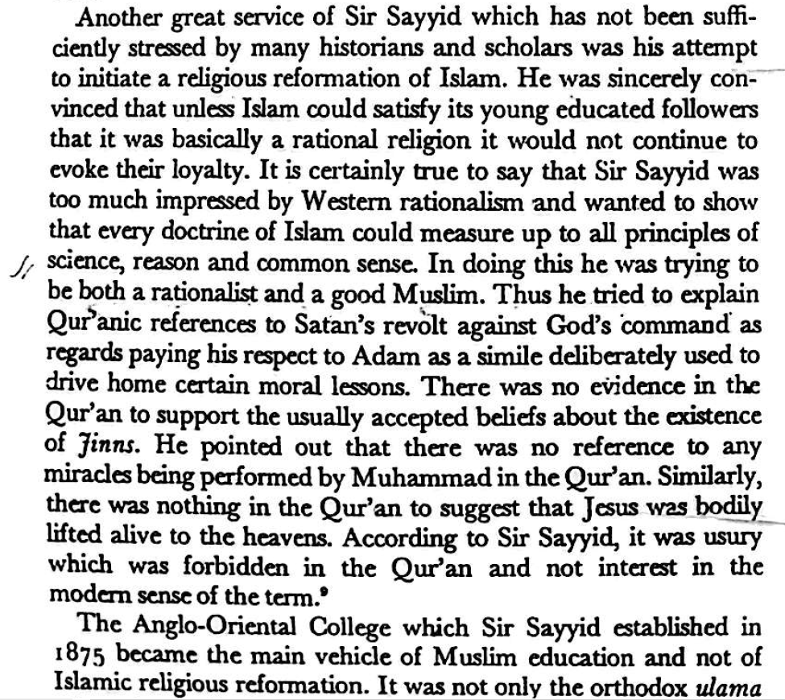
Sir Syed Ahmed Khan’s Religious Reformation:

Slide 16
Sir Syed Ahmed Khan’s Educational Reforms:
Sir Syed Ahmed Khan pledged with the Muslims to remain loyal to the British and not participate in the Congress movement. He felt that the Muslim community should remain aloof from all kinds of political agitation because by taking active role in the Indian Mutiny of 1857 they had already placed themselves in danger by arousing British antagonism.
The only path that lay before the Muslims, according to Sir Syed, was that of equipping themselves with English education.
He established the Anglo-Oriental College in 1875 which later became the well-known Muslim university of Aligarh (For details, See professor Khalid bin Sayeed, The Political System of Pakistan, Oxford, 1967).

Slide 17
DEMANDS AT THE SHIMLA CONFERENCE
SEPARATE ELECTORATES
GREATER WEIGHTAGE IN REPRESENTATION
GREATER WEIGHTAGE IN MUNICIPALITY, COLLEGE AND UNIVERSITY
SETTING UP MUSLIM UNIVERSITIES
MORE JOBS IN CIVIL SERVICES, ARMY AND JUDICIARY

Slide 18
Other Muslim reformers at a glance:
It was Nawab Abdul Latif (1828-1893) who in fact initiated the renaissance or the reawakening movement of the Muslims in Bengal. He was a social worker and pioneer of Muslim reawakening in 19th century Bengal. Nawab Abdul Latif (1828-1893) is considered as the architect and Khan Bahadur Ahsanullah (1873-1965) was one of the pioneers of the Renaissance in Bengal.

Slide 19
Syed Ismail Hossain Shiraji
Syed Ismail Hossain Shiraji (1880-1931) was born in Sirajganj, Pabna. He was a writer, orator and peasant leader. He was anti British and organized movements against the British. He suffixed the term Shiraji with his name for his love of the place where he was born in the year 1880 and died in 1931. Ismail Hossain Shiraji also inspired the Rebel Poet Kazi Nazrul Islam (1899 -1976). Poet Nazrul, born 19 years after his birth, was greatly inspired by his speech and the books he published at that time, most of which were anti-British and caused Siraji to suffer much at the hand of the British who imprisoned him and then confiscated his book Anal Probaho (Waves of Fire).

Slide 20
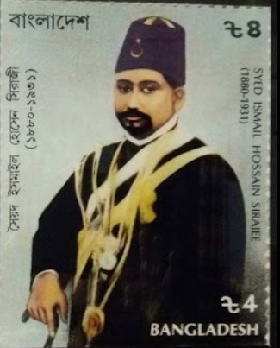
Syed Ismail Hossain Shiraji

Slide 21
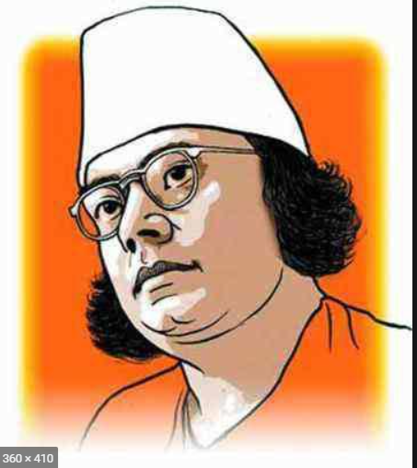
Kazi Nazrul Islam
Islam, Kazi Nazrul (1899-1976) national poet of Bangladesh, called the 'rebel poet' for his brave resistance to all forms of repression. His poetry, with its vibrant rhythms and iconoclastic themes, forms a striking contrast to rabindranath tagore's poetry. Though he had great regard and admiration for the older poets and writers, he did not imitate any poet or writer, even not Rabindranath, though it was a fashion of the day.

Slide 22
মোরা এক বৃন্তে দু'টি কুসুম হিন্দু-মুসলমান। মুসলিম তার নয়ন-মণি, হিন্দু তাহার প্রাণ॥

Slide 23
Through literature, journalism and political activism, Nazrul fought against foreign rule, communalism, imperialism, colonialism, fundamentalism and exploitation.
In response, the British colonial government proscribed his books and newspapers and put him behind bars. Through his written Rajbandir Jabanbandi (a political prisoner’s deposition) and his 40-day hunger strike, Nazrul protested against the harassment. In support of him, Rabindranath dedicated one of his books to him.

Slide 24
The Freedom of Intellect Movement in Bengali Muslim Thought, 1926-1938:
The Freedom of Intellect Movement(Buddhir Mukti Andolan) was a Bengal Renaissance Movement advocating rationality against religious and social dogma in Bengali Muslim society. It was spearheaded by intellectuals in the University of Dhaka during the British Raj.
Notable members included Kazi Abdul Wadud, Abul Fazal, Muhammad Shahidullah, Qazi Motahar Hossain, Kazi Nazrul Islam and Abdul Quadir.

Slide 25
Shikha the mouthpiece of the Muslim Sahitya-Samaj or literary society founded in Dhaka in 1926. Shikha was totally different from other contemporary periodicals. It drew due attention of the intellectuals with its very first issue. As it contained reports on the year-long activities of the Muslim Sahitya-Samaj, it naturally attracted the keen interest of its readers.
The mast of every issue of the journal carried this slogan: 'Where knowledge is limited, intellect is inert, freedom is impossible.'(‘জ্ঞান যেখানে সীমাবদ্ধ, বুদ্ধি সেখানে আড়ষ্ট, মুক্তি সেখানে অসম্ভব’ ).This slogan was regarded by the journal's writers as their motto or guiding principle.

Slide 26
Some enlightened Muslim groups like the Muslim Sahitya Samaj (founded in Dacca in 1926) launched parallel movements against such communal positions.
The Buddhir Mukti Andolon (movement for the emancipation of the intellect) tried to connect the idea of Muslim identity with the concept of ‘Pan-Indian identity’ through its mouthpiece Siksha. Kazi Abdul Wadud, one of its leading members, argued, a ‘Bengali Muslim is a human being first by the right of his birth, then a Bengali by being made of the soil of Bengal, and then a Muslim, and a Bengali Muslim last’ (Anindita Ghoshal, Refugees, Borders and Identities, London, 2021, pages 16-17).

Slide 27

